Slide 1


Slide 2
Some Terminology
Information – A collection of raw facts and figures
Data– Final product created from the raw data after processing
Database – A collection of related data organised in a structured way to allow easy retrieval of any one item

Slide 3
Database Systems -
Construct a data model of an existing, non computerised system
THE ANALYSIS PHASE

Slide 4
DATABASE SYSTEMS
Analysis Phase
Requirements Definition
Normalisation
Entity-Relationship Diagrams
Data Dictionaries
Functions

Slide 5
DATABASE SYSTEMS
Analysis
Requirements Definition
Normalisation
Entity-Relationship Diagrams
Data Dictionaries
Functions

Slide 6
REQUIREMENTS DEFINITION
When we normalise any type of database system we need to know what the data in the system means. Therefore we either have to talk to the people who use the existing system or we have to be supplied with very detailed information about how the system works and the data stored within it.
The following slide shows an example of some current data.
Below this are listed some questions that help establish the requirements of the new system.
Can you think of anything else the analyst might ask?
Notes:
Copy Note

Slide 7
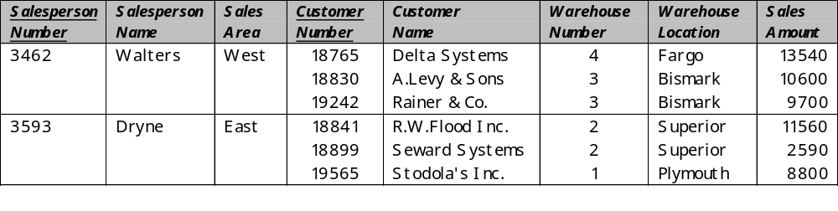
REQUIREMENTS DEFINITION
Does each salesperson have their own sales area?
Does each customer deal with only one salesperson ?
Does each customer only receive goods from one warehouse?
The answer to these questions will influence how we structure
the database system.
The answer to these questions and others make up the
Requirements Definition
Notes:
Copy Note

Slide 8
DATABASE SYSTEMS
Analysis
Requirements Definition
Normalisation
Entity-Relationship Diagrams
Data Dictionaries
Functions

Slide 9
FUNCTIONAL DEPENDENCY
Functional dependency means that there must be only a one-to-one dependency for each attribute mapped from a primary key to that attribute.
It defines a relationship in which the existence of one entity/attribute is entirely dependent on the existence of another (one-to-one).
For example, the engine number of a car [Primary Key] can only have engine capacity as an attribute of that key creating Functional Dependency
BUT
A particular engine capacity can be associated with the engine numbers of many makes of car. This does not give rise to Functional Dependency
Notes:
Copy Note

Slide 10
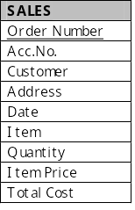
FUNCTIONAL DEPENDENCY - PRACTICAL EXAMPLE
Order Number is the primary key.
The value for each attribute of SALES,
except Item Price, depends upon the value
of the primary key.
All attributes of SALES, except Item Price,
are Functionally Dependent on the
primary key
Item Price is Functionally Dependent on the
the attribute Item
Notes:
Transactions table for video shop
Transaction No is primary key
Value for each attribute changes as Primary key changes
All attributes of transaction can be said to be functionally dependent upon the primary key

Slide 11
Relationships
Having established a definition for the term Functional Dependency we now need to explore the different types of relationships that can exist between attributes in different entities:
There are 3 types of relationships that can exist:
One to One Relationships
One to Many Relationships
Many to Many Relationships
Now lets take a closer look at each of these on the next slides

Slide 12

ENTITY RELATIONSHIPS
One-to-one
A blind person owns a guide dog which is exclusively theirs.
J. Smith
B. Jones
A. Gray
Rover
Pippa
Patch
Notes:
Copy

Slide 13

ENTITY RELATIONSHIPS
One-to-many
A doctor may have many patients, but a patient is assigned to only one doctor.
Dr Ache
Dr Payne
Grant
Allan
Mark
Jane
Amy
Notes:
Copy

Slide 14

ENTITY RELATIONSHIPS
Many-to-many
A film may have many stars and each star may act in many films.
Film X
Film Y
Star A
Star B
Star C
Notes:
Copy

Slide 15
Important Note:
An RDBMS system cannot produce a robust solution if two or more of the entities have a many to many relationship
To overcome this problem it is necessary to introduce another entity thus creating One to Many relationships between itself and the offending entities
This can become a common occurrence when you are working with larger and more complex database systems

Slide 16
Now you should have the tools and understanding you require in order to normalise the data in order that a solution can be produced using an RDBMS [Relational Database Management System]
Please take your time when working through the next part of this presentation and revisit it again and again until you are completely comfortable with the concepts involved
Normalisation of the data is perhaps the single most important aspect of developing a robust solution to any database problem!

Slide 17
NORMALISATION
Normalisation is a 'fancy' term for a
set of rules, designed to make sure that
a database is organised in the best way possible
This allows the data to be processed more efficiently and any query to be processed.
These rules depend on relationships being established between the entities to create a functional dependency between them.
Notes:
Copy

Slide 18
THE NORMALISATION PROCESS INVOLVES:
Finding and grouping together all the entities and their attributes.
Removing repeating groups of data.
  This is another way of saying that there is no point in storing a persons' name and details etc. in many different places within a database.
Providing unique keys for each entity in the database system.
  You need to have a way of making sure that when you delete 'Paul Smith' from the Transactions entity that it is the correct person.
Notes:
Copy by stage

Slide 19
THE THREE MAJOR STAGES OF NORMALISATION:
First Normal Form
  1NF is the first level of normalisation. An entity (table) is in First Normal form if it contains no repeating attributes (fields) or groups of attributes.
Second Normal Form
  An entity is in 2NF if no attribute (not part of the primary key) is dependent on only part of the primary key. This only applies to entities with concatenated primary keys.
Third Normal Form
  An entity is in 3NF if all attributes are entirely dependent on the primary key and not on any attribute that is not part of the primary key.
Notes:
Copy by stage

Slide 20
TO PRODUCE A SET OF ENTITIES IN FIRST NORMAL FORM (1NF):
Remove repeating (multiple) groups within the primary entities (tables) so that each record (row) within the entity is the same length.
Repeating groups then become new entities, linked together by a one-to-many relationship.
Relationships are created by including a primary key from one entity as a foreign key in another entity
Notes:
Copy by stage

Slide 21
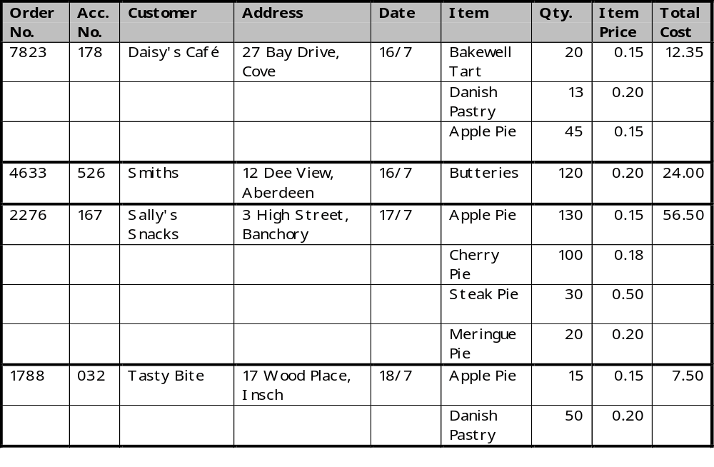
CHARLIE’S BAKER SHOP
Notes:
Table for a video bakers shop - describe attributes
For 1NF we require fixed length records

Slide 22
CHARLIE’S BAKER SHOP
Notes:
We can see that Order No. 7823 has repeating (multiple) entries for Item, Quantity & Item Price, and so on...

Slide 23
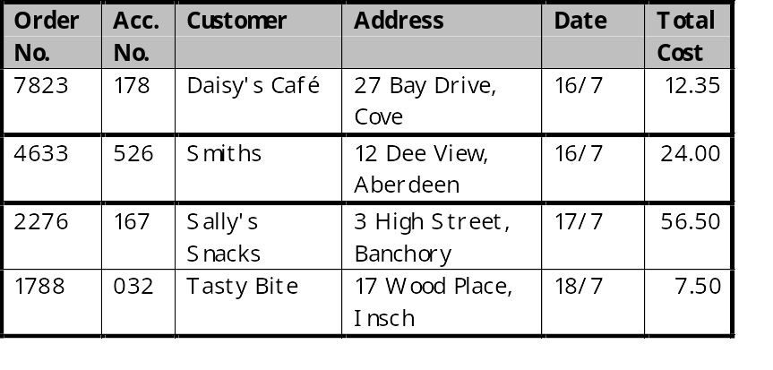
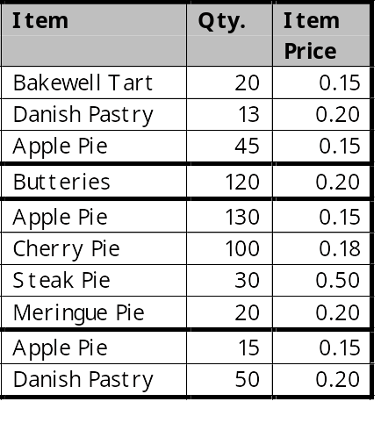
CHARLIE’S BAKER SHOP
Orders
Items Purchased
Notes:
Remove repeating groups
Form new entities (tables)

Slide 24
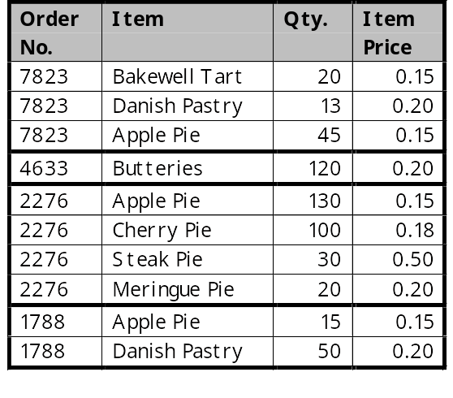
CHARLIE’S BAKER SHOP
Orders
Items Purchased
Notes:
To complete 1NF we need to create the relationship between the tables -
this is achieved by repeating the Order No. field in each table.

Slide 25
CHARLIE’S BAKER SHOP
Orders Table:
Order No. can be used to uniquely identify each record and can
therefore be made the primary key.
Orders (Order No.
Acc. No.
Customer
Address
Date
Total Cost)
Notes:
Assign primary key to each table
Orders - Order No uniquely identifies each record.

Slide 26
CHARLIE’S BAKER SHOP
Items Purchased Table:
No one attribute can be used to
uniquely identify a record.
Concatenated key is required
Order No. and Item together can
uniquely identify a record.
Items (*Order No.
Purchased Item
Quantity
Item Price)
Notes:
Items purchased - no one attribute can be used to uniquely identify a single record.
If we choose Order No. there is no unique association
If we choose Item. there is no unique association etc
We must therefore create a CONCATENATED KEY - so what do we need to find each record in the entity?
We can use Order No. AND Item to uniquely identify each record

Slide 27
CHARLIE’S BAKER SHOP
FIRST NORMAL FORM
Orders (Order No.
Acc. No.
Customer
Address
Date
Total Cost)
Items (*Order No.
Purchased Item
Quantity
Item Price
Notes:
Tables in 1NF

Slide 28
THE THREE MAJOR STAGES OF NORMALISATION:
First Normal Form
  1NF is the first level of normalisation. An entity (table) is in First Normal form if it contains no repeating attributes (fields) or groups of attributes.
Second Normal Form
  An entity is in 2NF if no attribute (not part of the primary key) is dependent on only part of the primary key. This only applies to entries with concatenated primary keys.
Third Normal Form
  An entity is in 3NF if all attributes are entirely dependent on the primary key and not on any attribute that is not part of the primary key.
Notes:
Copy by stage

Slide 29
TO PRODUCE A SET OF ENTITIES IN SECOND NORMAL FORM (2NF):
Test for dependency by testing each particular attribute in turn to check that it can be uniquely identified by making use of all the primary key. This test need not be completed unless you have at least one table which requires a concatenated Primary Key
Remove all partially dependent attributes to a new entity.
N.B. – A concatenated key occurs when you need two fields together in order to uniquely identify a record
Notes:
Copy by stage

Slide 30
CHARLIE’S BAKER SHOP
FIRST NORMAL FORM
Orders (Order No.
Acc. No.
Customer
Address
Date
Total Cost)
Items (*Order No.
Purchased Item
Quantity
Item Price)
Notes:
Tables in 1NF

Slide 31
CHARLIE’S BAKER SHOP
Orders Table:
Because this entity has a single attribute as the primary key
there can be no partial dependencies and therefore the entity
is already in 2NF.
Notes:
Assign primary key to each table
Orders - Order No uniquely identifies each record.

Slide 32
CHARLIE’S BAKER SHOP
(2NF STEP 1)
Items Purchased Table:
Primary key is Order No. and Item
Test for dependency by testing each
particular attribute.
Primary Key Attribute Functionally Dependent?
Notes:
Items purchased - no one attribute can be used to uniquely identify a single record.
If we choose Order No. there is no unique association
If we choose Item. there is no unique association etc
We must therefore create a CONCATENATED KEY - so what do we need to find each record in the entity?
We can use Order No. AND Item to uniquely identify each record

Slide 33
CHARLIE’S BAKER SHOP
(2NF STEP 1)
Items Purchased Table:
Primary key is Order No. and Item
Test for dependency by testing each
particular attribute.
Primary Key Attribute Functionally Dependent?
Order No Quantity YES
Item Quantity is functionally dependent
on Order No. and Item.
Notes:
Items purchased - no one attribute can be used to uniquely identify a single record.
If we choose Order No. there is no unique association
If we choose Item. there is no unique association etc
We must therefore create a CONCATENATED KEY - so what do we need to find each record in the entity?
We can use Order No. AND Item to uniquely identify each record

Slide 34
CHARLIE’S BAKER SHOP
(2NF STEP 1)
Primary Key Attribute Functionally Dependent?
Order No Quantity YES
Item Quantity is functionally dependent
on Order No. and Item.
Order No Item Price NO
Item Item price is functionally dependent
Item, but not on Order No. and Item
Notes:
Items purchased - no one attribute can be used to uniquely identify a single record.
If we choose Order No. there is no unique association
If we choose Item. there is no unique association etc
We must therefore create a CONCATENATED KEY - so what do we need to find each record in the entity?
We can use Order No. AND Item to uniquely identify each record

Slide 35
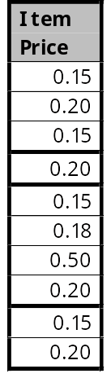
CHARLIE’S BAKER SHOP
(2NF STEP 2)
Remove any partially dependent attributes to a new entity
Notes:
Items purchased - no one attribute can be used to uniquely identify a single record.
If we choose Order No. there is no unique association
If we choose Item. there is no unique association etc
We must therefore create a CONCATENATED KEY - so what do we need to find each record in the entity?
We can use Order No. AND Item to uniquely identify each record

Slide 36
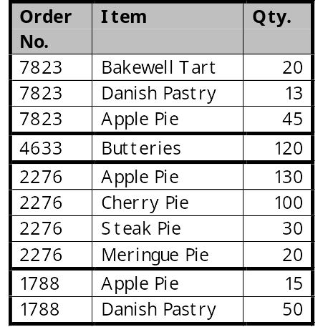
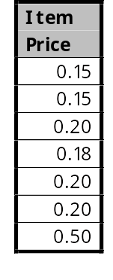
CHARLIE’S BAKER SHOP
(2NF STEP 2)
Part Order
Price List
Notes:
Items purchased - no one attribute can be used to uniquely identify a single record.
If we choose Order No. there is no unique association
If we choose Item. there is no unique association etc
We must therefore create a CONCATENATED KEY - so what do we need to find each record in the entity?
We can use Order No. AND Item to uniquely identify each record

Slide 37
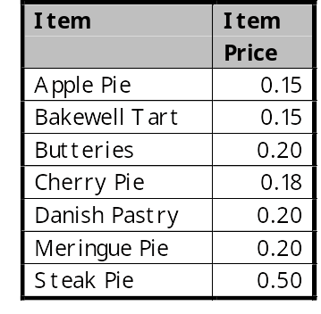
CHARLIE’S BAKER SHOP
(2NF STEP 2)
Create a relationship between the tables
and assign Primary Keys
Part Order
Price List
Primary Key: Order No.
and *Item
Primary Key: Item
Notes:
Items purchased - no one attribute can be used to uniquely identify a single record.
If we choose Order No. there is no unique association
If we choose Item. there is no unique association etc
We must therefore create a CONCATENATED KEY - so what do we need to find each record in the entity?
We can use Order No. AND Item to uniquely identify each record

Slide 38
CHARLIE’S BAKER SHOP
SECOND NORMAL FORM
Orders (Order No.
Acc. No.
Customer
Address
Date
Total Cost)
Price List (Item
Item Price)
Part Order (*Order No.
*Item
Quantity)
Notes:
Tables in 1NF

Slide 39
THE THREE MAJOR STAGES OF NORMALISATION:
First Normal Form
  1NF is the first level of normalisation. An entity (table) is in First Normal form if it contains no repeating attributes (fields) or groups of attributes.
Second Normal Form
  An entity is in 2NF if no attribute (not part of the primary key) is dependent on only part of the primary key. This only applies to entries with concatenated primary keys.
Third Normal Form
  An entity is in 3NF if all attributes are entirely dependent on the primary key and not on any attribute that is not part of the primary key.
Notes:
Copy by stage

Slide 40
TO PRODUCE A SET OF ENTITIES IN THIRD NORMAL FORM (3NF):
Test each attribute in turn to check for dependency on the primary key.
Remove all transitive dependencies to a new entity.
  A transitive dependency is where an attribute is dependent on another attribute (or attributes) that is (are) NOT the primary key
Notes:
Copy by stage

Slide 41
CHARLIE’S BAKER SHOP
SECOND NORMAL FORM
Orders (Order No.
Acc. No.
Customer
Address
Date
Total Cost)
Price List (Item
Item Price)
Part Order (*Order No.
*Item
Quantity)
Notes:
Tables in 1NF

Slide 42
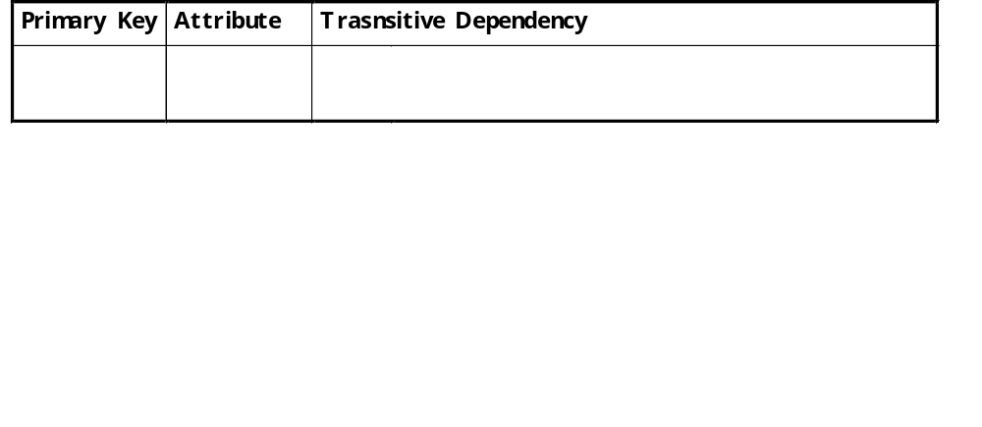
CHARLIE’S BAKER SHOP - 3NF STEP1
Test for
dependency
Notes:
Assign primary key to each table
Orders - Order No uniquely identifies each record.

Slide 43
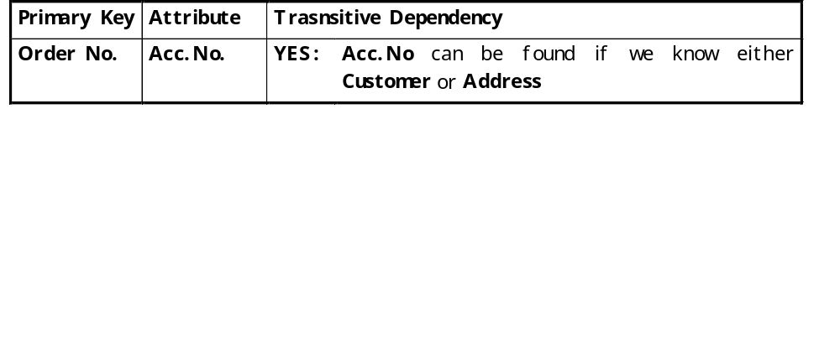
CHARLIE’S BAKER SHOP - 3NF STEP1
Test for
dependency
Notes:
Assign primary key to each table
Orders - Order No uniquely identifies each record.

Slide 44
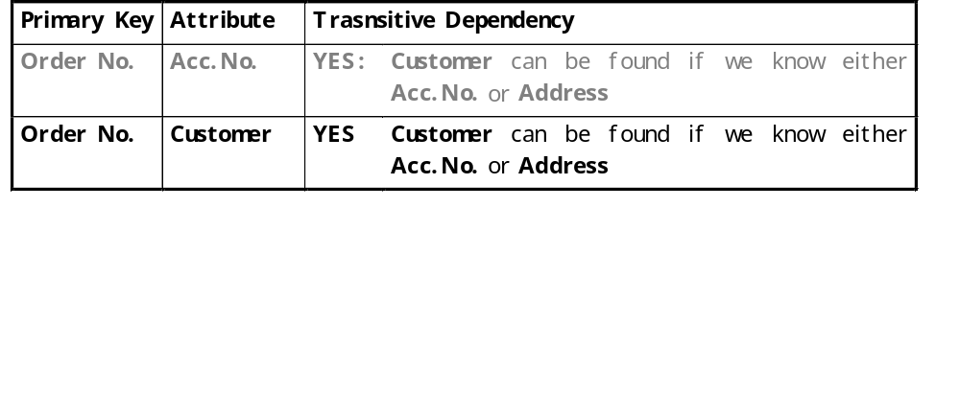
CHARLIE’S BAKER SHOP - 3NF STEP1
Test for
dependency
Notes:
Assign primary key to each table
Orders - Order No uniquely identifies each record.

Slide 45
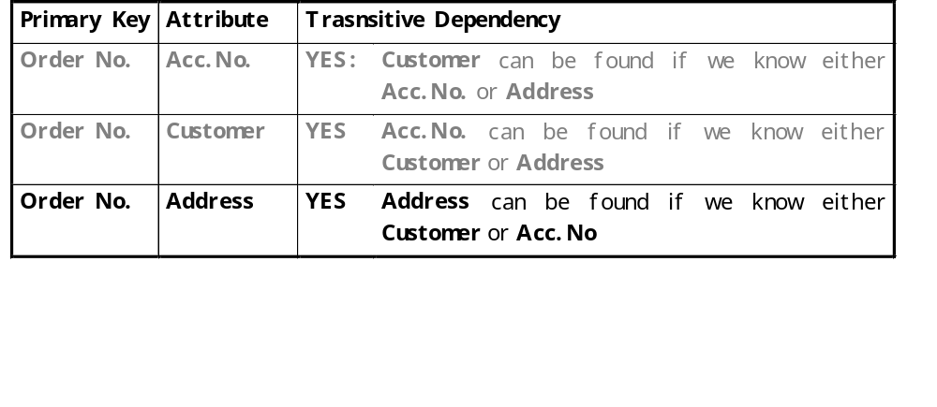
CHARLIE’S BAKER SHOP - 3NF STEP1
Test for
dependency
Notes:
Assign primary key to each table
Orders - Order No uniquely identifies each record.

Slide 46
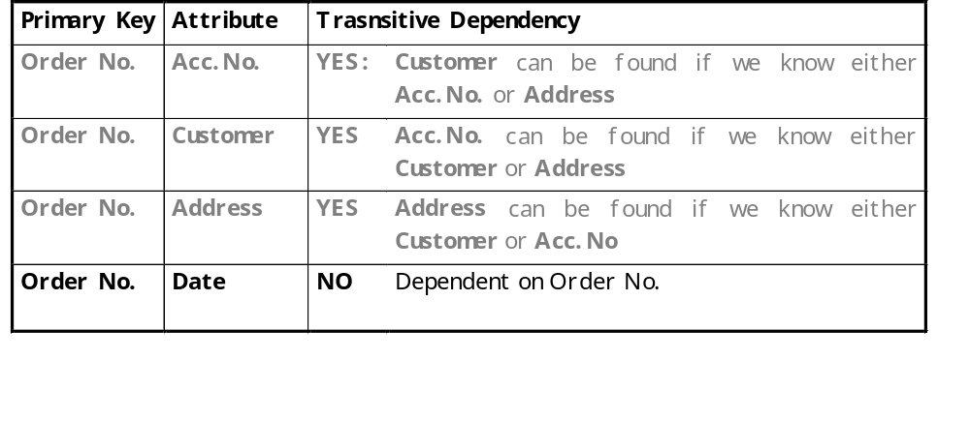
CHARLIE’S BAKER SHOP - 3NF STEP1
Test for
dependency
Notes:
Assign primary key to each table
Orders - Order No uniquely identifies each record.

Slide 47
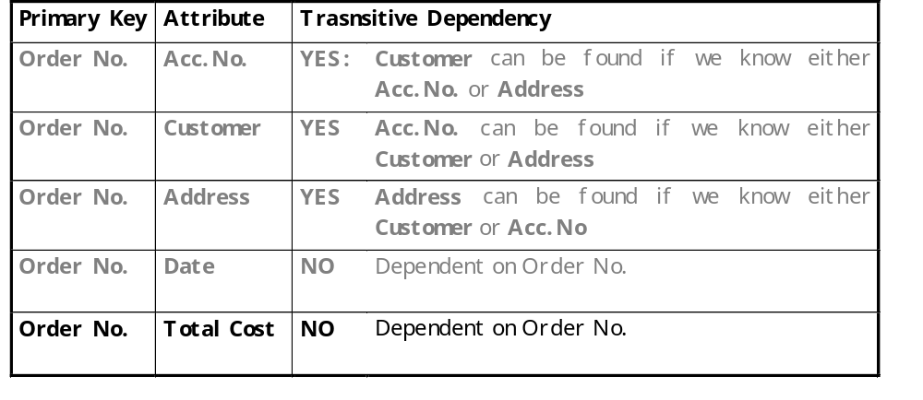
CHARLIE’S BAKER SHOP - 3NF STEP1
Test for
dependency
Notes:
Assign primary key to each table
Orders - Order No uniquely identifies each record.

Slide 48
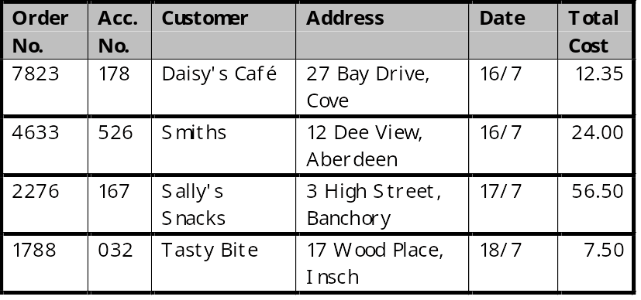
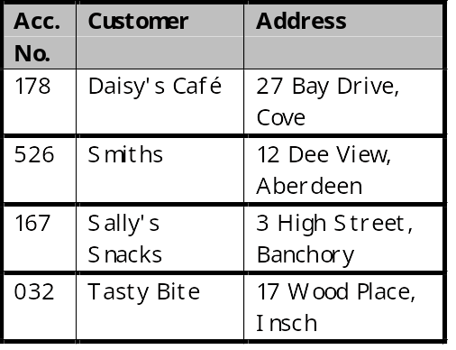
CHARLIE’S BAKER SHOP - 3NF STEP2
Remove transitive dependencies to a new entity
Notes:
Assign primary key to each table
Orders - Order No uniquely identifies each record.

Slide 49
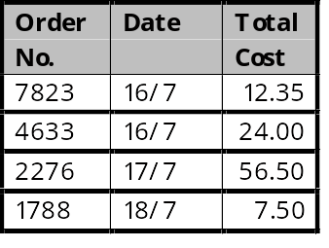
CHARLIE’S BAKER SHOP - 3NF STEP2
Remove transitive dependencies to a new entity
Orders
Customers
Notes:
Assign primary key to each table
Orders - Order No uniquely identifies each record.

Slide 50
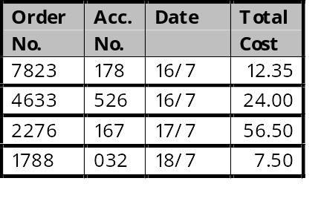
CHARLIE’S BAKER SHOP - 3NF STEP2
Create a relationship between the tables
and assign Primary Keys
Orders
Customers
Primary Key:
Order No.
Primary Key:
Acc.No.
Notes:
Assign primary key to each table
Orders - Order No uniquely identifies each record.

Slide 51
CHARLIE’S BAKER SHOP
THIRD NORMAL FORM
Customers (Acc. No.
Customer
Address)
Orders (Order No.
*Acc. No.
Date
Total Cost)
Part Order (*Order No.
*Item
Quantity)
Price List (Item
Item Price)
Normalisation Complete
Notes:
Tables in 1NF

Slide 52

Normalisation -
The Six Point Plan
1. Remove repeating groups to create a new entity
2. Create a relationship using one of the attributes that are left [Usually the primary key]
1NF
3.‘Check out’ entities with concatenated keys. If any attribute is not fully dependent on both parts of the primary key remove it to create a new entity.
4. Create a relationship using one of the attributes that are left [Usually the primary key]
2NF
5.‘Check out’ every entity. If any attribute is dependent on any attribute other than the primary key, remove it into a new entity.
6. Create a relationship using one of the attributes
3NF

Slide 53
DATABASE SYSTEMS
Analysis
Requirements Definition
Normalisation
Entity-Relationship Diagrams
Data Dictionaries
Functions

Slide 54
ENTITY - RELATIONSHIP DIAGRAMS
E-R diagrams show the structure of the data to be modelled.
They are a convenient method for representing the relationships, entities and attributes in a system.
This is done by illustrating a system with a diagram to produce a detailed specification for each entity and the attributes within them.
Notes:
Copy by stage

Slide 55
SYMBOLS USED IN AN E – R DIAGRAM
Entity – a collection of data [table]
ENTITY
Attribute – a data item in an entity [field]
ATTRIBUTE
Notes:
Copy by stage

Slide 56
SYMBOLS USED IN AN E – R DIAGRAM
KEY ATTRIBUTE
Key Attribute – a data item which makes up the primary key or part of it.
Relationship – a description of the link between two entities.
RELATIONSHIP
Notes:
Copy by stage

Slide 57
Simple Examples
1. A blind person owns a guide dog
1
1
Blind Person
owns
Guide Dog
2. A doctor treats many patients
1
M
Doctor
treats
Patients

Slide 58
Simple Examples
3. A film may have many stars and
each star may be in many films.
M
N
Film
has
Stars

Slide 59
CHARLIE’S BAKER SHOP
THIRD NORMAL FORM
Customers (Acc. No.
Customer
Address)
Orders (Order No.
*Acc. No.
Date
Total Cost)
Part Order (*Order No.
*Item
Quantity)
Price List (Item
Item Price)
Notes:
Tables in 1NF

Slide 60
Determine the relationships between the
entities.
1
M
Customers
places
Orders
1
Charlie’s Baker Shop
contains
M
1
M
Price List
has
Part Order

Slide 61
CHARLIE’S BAKER SHOP
THIRD NORMAL FORM
Customers (Acc. No.
Customer
Address)
Orders (Order No.
*Acc. No.
Date
Total Cost)
Part Order (*Order No.
*Item
Quantity)
Price List (Item
Item Price)
Notes:
Tables in 1NF

Slide 62
Order No
List the attributes alongside
each entity
*Acc. No
Total Cost
1
M
Date
Customers
places
Orders
Acc.No
1
Customer
Charlie’s Baker Shop
contains
Address
M
1
M
Price List
has
Part Order
*Order No
Item
*Item
Item Price
Quantity

Slide 63
Data Types
The data types and formats used at this stage will be general and will be mapped on to those available in the RDBMS [Relational Database Management System] in the design phase.

